Slide 1

Computer Graphics and Image Processing
Geometry I

Slide 2
Today’s Outline
Points, Vectors and Matrices
The Dot Product ⋅
The Cross Product ×

Slide 3
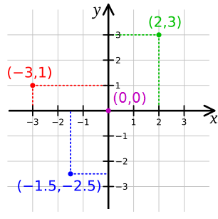

Points, Vectors and Matrices

Slide 4
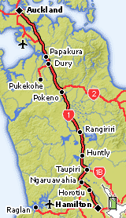
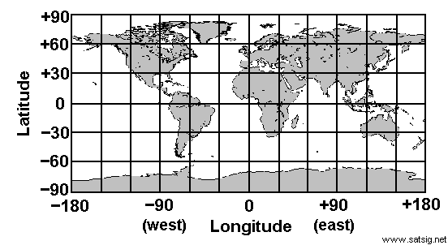
Points and Vectors
Cartesian coordinate system: orthogonal axes with numbers (coordinates) Origin: where all coordinates are zero (center)
Point: a position in space, e.g. Auckland Given as pair (x,y) of coordinate values
Vector: a displacement / difference between two points (direction + length)
Example: Where is Hamilton?
Point: 37.43S Latitude, 175.19E Longitude
Vector: 120km to the south-south-west of Auckland

Slide 5

Representing Points and Vectors
Points are represented as tuples
2D: 2-tuples (x, y) with x and y coordinates
3D: 3-tuples (x, y, z) with x, y, z coordinates
Vectors are also represented as tuples, but usually written as a column instead of a row x component
and y component (in 3D also z component)
Position vector of a point: vector from origin to the point (often convenient to use vectors instead of points)
Our notation:
Points are written in capital letters, e.g. P
Vectors in small bold letters, e.g. position vector of P is p
y
z
x
Right-handed 3D coordinate system

Slide 6
Operations on Points and Vectors
2 a
Vectors
Add, subtract
Scale (change length)
Points
Subtracting one point from another gives a vector (displacement)
Cannot add two points (Auckland + Hamilton = ???), but can add and subtract their position vectors
b
a
a
a+b
0.5 a
P
P
p+q
P-Q=p-q
Q
Q
O
O

Slide 7
Basic Operations on Vectors
Addition
Represents the combined displacement
Add corresponding components
Subtraction
Subtract the corresponding components
Same as addition of a negated vector, i.e. one in opposite direction
Scaling
Changing the length
Defined such that v + v = 2v
Multiply all components by the scalar
Magnitude of a vector
Calculating its "length" or 2-norm
Normalization
Scaling vector so that it has length 1 (unit vector)
Scale by reciprocal of magnitude
u
u₂
u₁

Slide 8

Matrices
row
Matrix: several vectors stuck together
m×n matrix has m rows and n columns
Like m row vectors or n column vectors
Operations
Addition/Subtraction: like adding/subtracting several vectors at the same time
Scaling: like scaling several vectors at the same time
column

Slide 9
Matrix Multiplication
Multiplying an l× m matrix B and an m × n matrix C gives an l × n matrix A with
“Rows times columns” with the products summed up
Elements of A are the dot products of the row vectors of B and column vectors of C
Can be used to transform several vectors simultaneously

Slide 10
Identity and Inverse
Identity matrix I: Neutral element of matrix multiplication, i.e. for all M: I M = M I = M
Inverse matrix M⁻¹ of a square matrix M (does not always exist):
M M⁻¹ = M⁻¹ M = I and (M⁻¹) ⁻¹ = M
Inverse of a 2x2 matrix:
Exists only if m₁₁ m₂₂ – m₁₂ m₂₁ ≠ 0
m₁₁ m₂₂ – m₁₂ m₂₁ is |M|, the matrix determinant

Slide 11
The Transpose Operation ^{T}
Make rows out of columns (or vice versa)
Transpose of a row vector is a column vector (and vice versa)
For matrix M: m_{ij} and m_{ji} are swapped for all i=1..m, j=1..n
Rules:
(M^{T})^{T}=M
(sM)^{T}=s(M^{T})
(M+N)^{T}=M^{T}+N^{T}
(MN)^{T}=N^{T}M^{T}

Slide 12
THE DOT PRODUCT ⋅

Slide 13
The Dot Product •
Takes two vectors u and v, the result is a scalar (a single number)
(therefore also known as scalar product)
(θ is the angle between u and v)
Rules:
a•b=b•a (Symmetry)
(a+b)•c=a•c+b•c (Linearity)
(sa)•b=s(a•b) (Homogeneity)
|b|²= b•b
Example: |a - b|² = (a - b) • (a - b) = a • a - 2a • b + b • b
u
θ
v

Slide 14
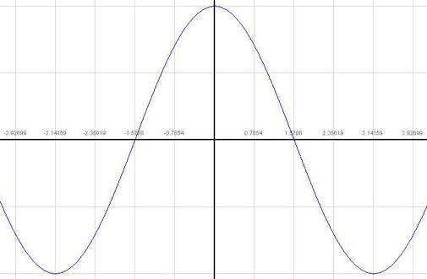
The Angle between Two Vectors
Most important application of dot product: find angle between two vectors (or two intersecting lines)
Two non-zero vectors b and c with common start point are:
less than 90º apart if b•c>0
exactly 90º apart if b•c=0 [b and c are orthogonal (perpendicular)]
more than 90º apart if b•c<0
cos

Slide 15
Orthogonal Projection of a Vector
Projecting a vector b onto another vector a:
L is a line through A with direction a
b is the vector from A to B
Given: a and b
Wanted: b_{a} (orthogonal projection of b onto a)
Solution:
Length of b_{a}: because of def. •
Vector b_{a}: because
θ

Slide 16
Distance from a Line to a Point
L is a line through A with direction a
b is the vector from A to B
Given: a and b
Wanted:
Solution:
θ

Slide 17
THE CROSS PRODUCT ×

Slide 18
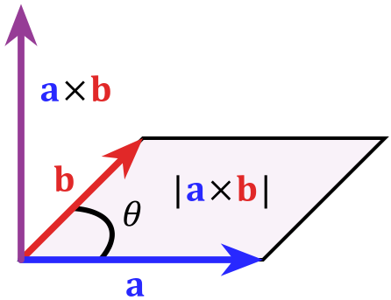
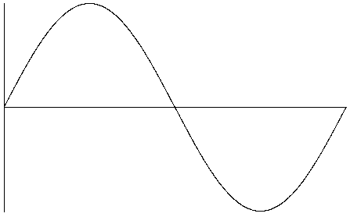
The Cross Product ×
Takes two 3D vectors u and v, the result is a 3D vector
(therefore also known as vector product)
θ is the angle between a and b
n is unit normal vector (|n|=1) orthogonal to a and b
Hard to remember?
Rules:
(a+b)×c = a×c + b×c (Linearity)
(sa)×b = s(a×b) (Homogeneity)
(no symmetry)
sin

Slide 19
Properties of the Cross Product
a × b is a vector perpendicular/orthogonal to both a and b
Direction of a × b is given by "right-hand rule"
a × b = – b × a
|a × b| is area of parallelogram defined by a and b
Area of triangle defined by a and b is 0.5 * |a × b|
b
c
a
a
b

Slide 20
SUMMARY

Slide 21
Summary
Vectors: addition, subtraction, scaling, magnitude, normalization
Matrices: addition, subtraction, scaling, multiplication
Dot product:
Cross product:
References:
Vectors: Hill, Chapter 4.2
Dot Product: Hill, Chapter 4.3
Cross Product: Hill, Chapter 4.4

Slide 22
Quiz
Calculate: a+b, |b| a, Ma, MN, a⋅b, a×b
What can you tell about the angle between a and b?
What is the projection of b onto a?
What is the distance between the point given by b and the line going through the origin along a?

